Slide 1
CSE 317: Decision Trees
(with some slides integrated from those of Tom Mitchell, Jesse Davis, Andrew Ng, and Pedro Domingos.)

Slide 2
Will I play tennis today?
Features
Outlook: {Sun, Overcast, Rain}
Temperature: {Hot, Mild, Cool}
Humidity: {High, Normal, Low}
Wind: {Strong, Weak}
Labels
Binary classification task: Y = {+, -}
5

Slide 3
Will I play tennis today?
Outlook: S(unny), O(vercast), R(ainy)
Temperature: H(ot), M(edium), C(ool)
Humidity: H(igh), N(ormal), L(ow)
Wind: S(trong), W(eak)
 | O | T | H | W | Play?
1 | S | H | H | W | -
2 | S | H | H | S | -
3 | O | H | H | W | +
4 | R | M | H | W | +
5 | R | C | N | W | +
6 | R | C | N | S | -
7 | O | C | N | S | +
8 | S | M | H | W | -
9 | S | C | N | W | +
10 | R | M | N | W | +
11 | S | M | N | S | +
12 | O | M | H | S | +
13 | O | H | N | W | +
14 | R | M | H | S | -
6

Slide 4
Basic Decision Trees Learning Algorithm
Data is processed in Batch (i.e. all the data available)
Recursively build a decision tree top down.
 | O | T | H | W | Play?
1 | S | H | H | W | -
2 | S | H | H | S | -
3 | O | H | H | W | +
4 | R | M | H | W | +
5 | R | C | N | W | +
6 | R | C | N | S | -
7 | O | C | N | S | +
8 | S | M | H | W | -
9 | S | C | N | W | +
10 | R | M | N | W | +
11 | S | M | N | S | +
12 | O | M | H | S | +
13 | O | H | N | W | +
14 | R | M | H | S | -
Outlook
Sunny
Overcast
Rain
Humidity
Yes
Wind
High
Normal
Strong
Weak
No
Yes
No
Yes
7

Slide 5
Decision Tree Classification
Decision tree
A flow-chart-like tree structure
Internal node denotes a test on an attribute
Branch represents an outcome of the test
Leaf nodes represent class labels or class distribution
Decision tree generation consists of two phases
Tree construction
At start, all the training examples are at the root
Partition examples recursively based on selected attributes
Tree pruning
Identify and remove branches that reflect noise or outliers
Use of decision tree: Classifying an unknown sample
Test the attribute values of the sample against the decision tree

Slide 6
How do we construct the decision tree?
Basic algorithm (a greedy algorithm)
Tree is constructed in a top-down recursive divide-and-conquer manner
At start, all the training examples are at the root
Attributes are categorical (if continuous-valued, they can be discretized in advance)
Examples are partitioned recursively based on selected attributes.
Test attributes are selected on the basis of a heuristic or statistical measure (e.g., information gain)
Conditions for stopping partitioning
All samples for a given node belong to the same class
There are no remaining attributes for further partitioning – majority voting is employed for classifying the leaf
There are no samples left

Slide 7
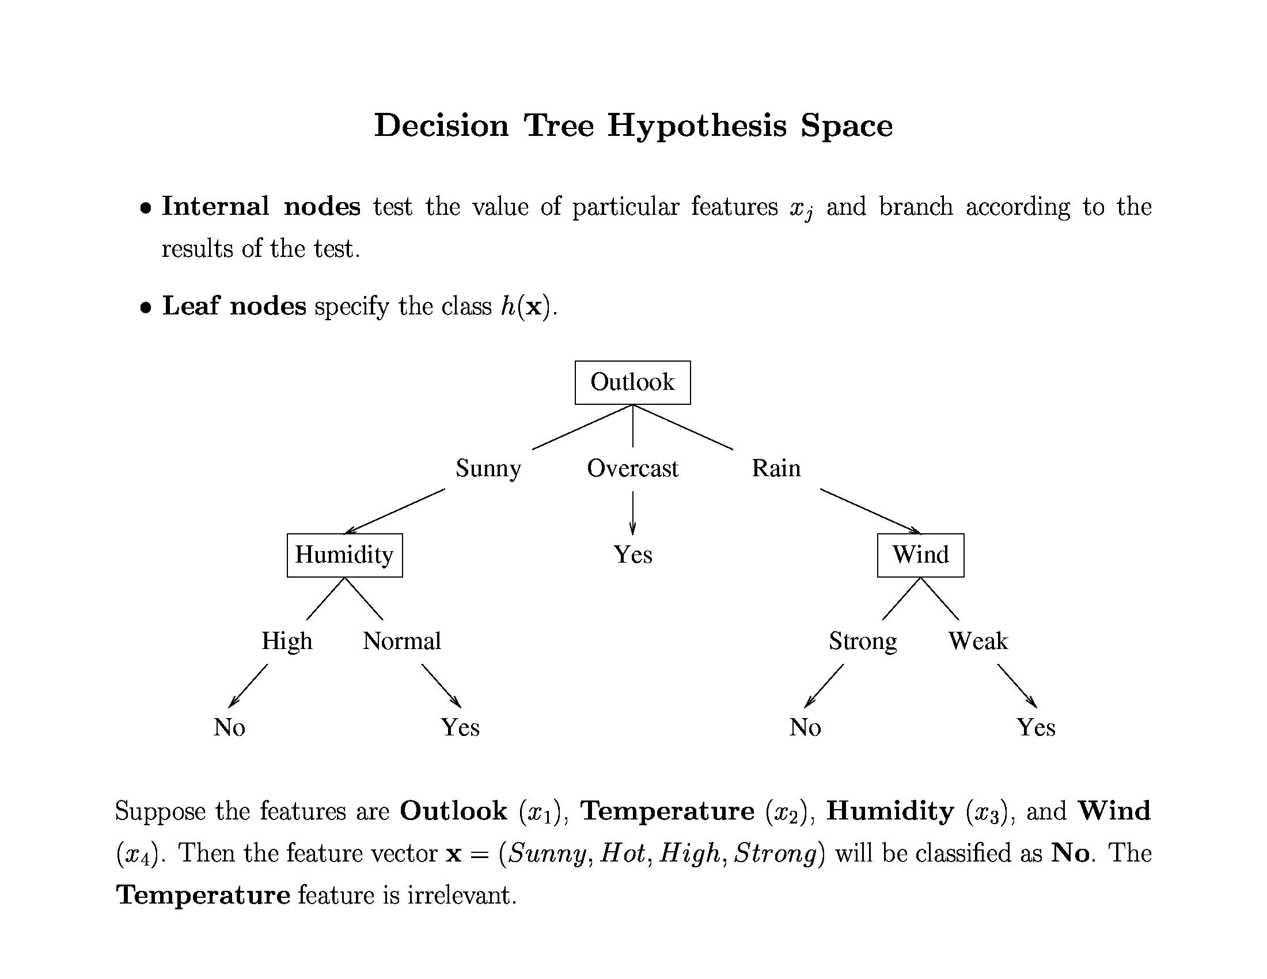
Shall I play tennis today?
10

Slide 8
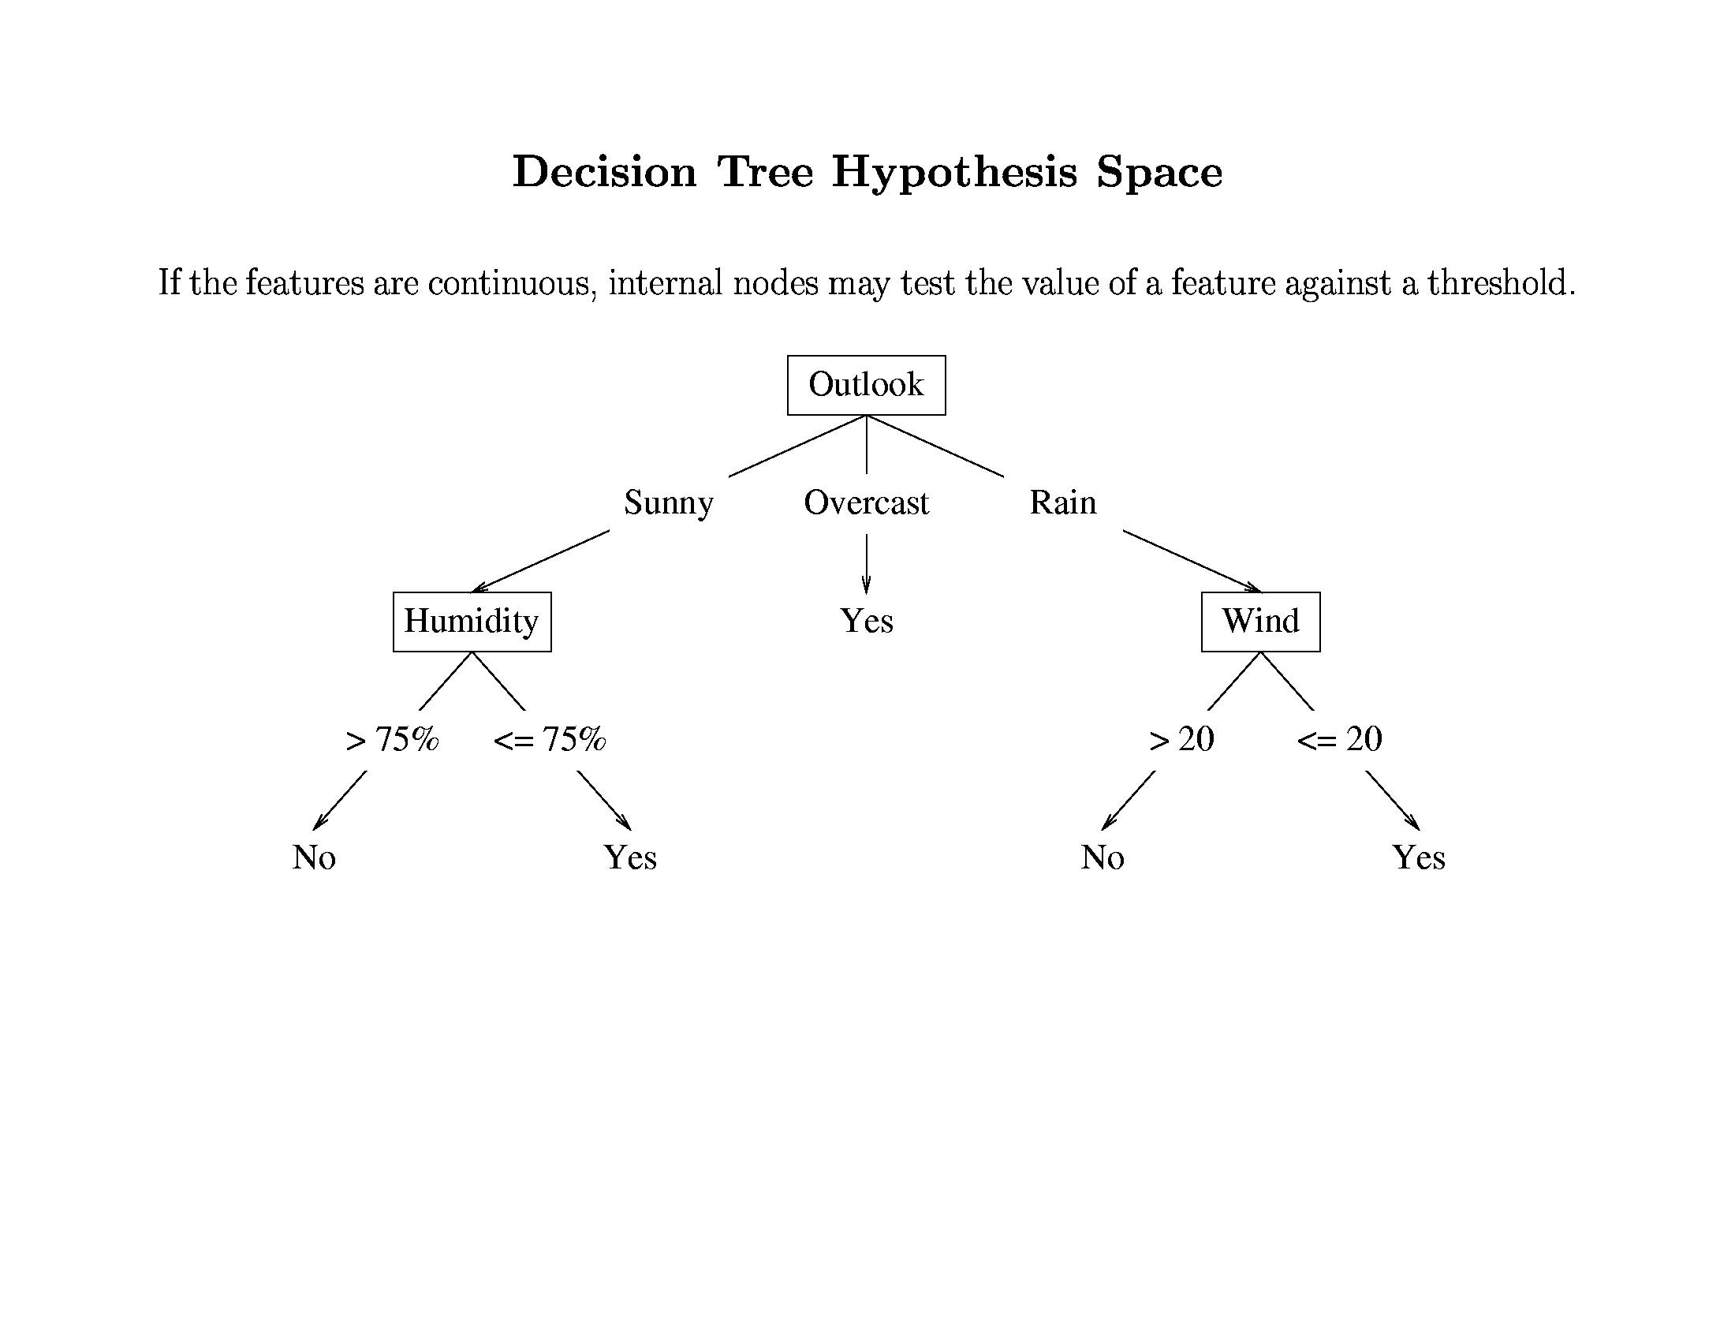
11

Slide 9
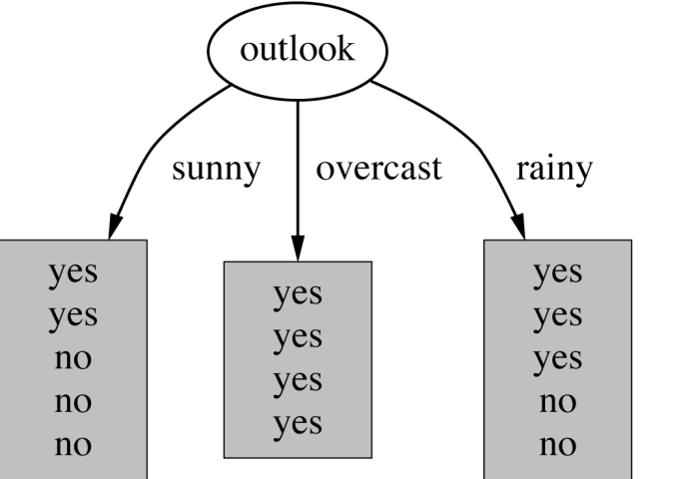
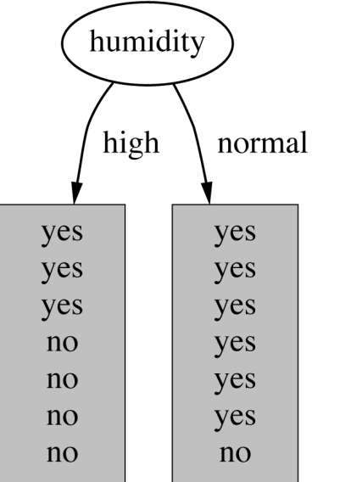
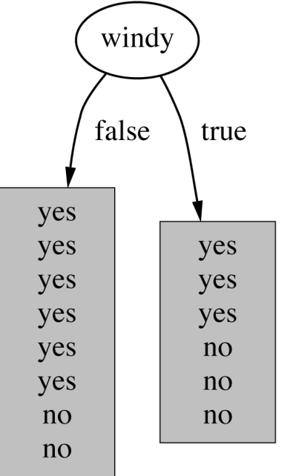
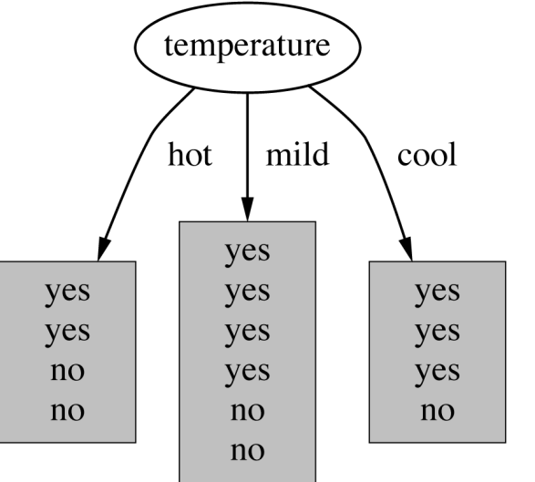
Which attribute to select?
13
witten&eibe

Slide 10
Which attribute to select?
The goal is to have the resulting decision tree as small as possible (Occam’s Razor)
But, finding the minimal decision tree consistent with the data is NP-hard
The recursive algorithm is a greedy heuristic search for a simple tree, but cannot guarantee optimality
The main decision in the algorithm is the selection of the next attribute to condition on
14

Slide 11
Criterion for attribute selection
Which is the best attribute?
The one which will result in the smallest tree
Heuristic: choose the attribute that produces the “purest” nodes
Need a good measure of purity!
Maximal when?
Minimal when?
15

Slide 12
Information Gain
Which test is more informative?
Split over whether Balance exceeds 50K
Split over whether applicant is employed
Less or equal 50K
Over 50K
Unemployed
Employed
16

Slide 13
Information Gain
Impurity/Entropy (informal)
Measures the level of impurity in a group of examples
17

Slide 14
Impurity
Very impure group
Less impure
Minimum
impurity
18

Slide 15
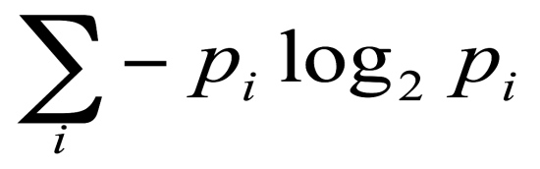
Entropy: a common way to measure impurity
Entropy =
p_{i} is the probability of class i
Compute it as the proportion of class i in the set.
Entropy comes from information theory. The higher the entropy the more the information content.
What does that mean for learning from examples?
19

Slide 16
2-Class Cases:
Minimum
impurity
What is the entropy of a group in which all examples belong to the same class?
entropy = - 1 log₂1 = 0
What is the entropy of a group with 50% in either class?
entropy = -0.5 log₂0.5 – 0.5 log₂0.5 =1
not a good training set for learning
Maximum
impurity
good training set for learning
20

Slide 17
Information Gain
We want to determine which attribute in a given set of training feature vectors is most useful for discriminating between the classes to be learned
Information gain tells us how important a given attribute of the feature vectors is
We will use it to decide the ordering of attributes in the nodes of a decision tree
21

Slide 18
Picking the Root Attribute
The goal is to have the resulting decision tree as small as possible (Occam’s Razor)
The main decision in the algorithm is the selection of the next attribute to condition on
We want attributes that split the examples to sets that are relatively pure in one label; this way we are closer to a leaf node
The most popular heuristics is based on information gain, originated with the ID3 system of Quinlan
25

Slide 19

Information Gain
The information gain of an attribute a is the expected reduction in entropy caused by partitioning on this attribute
where S_{v} is the subset of S for which attribute a has value v, and the entropy of partitioning the data is calculated by weighing the entropy of each partition by its size relative to the original set
High Entropy – High level of Uncertainty
Low Entropy – No Uncertainty.

Slide 20
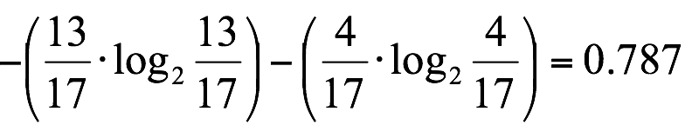
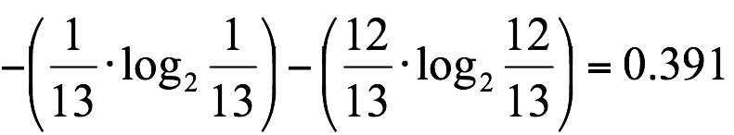
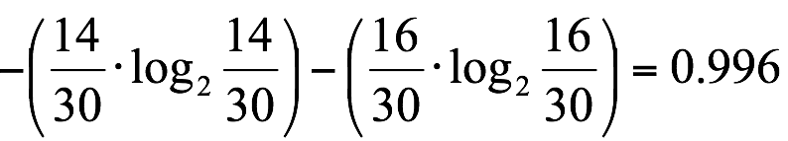
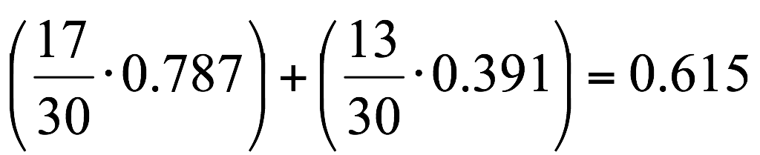
Calculating Information Gain
Information Gain = entropy(parent) – [average entropy(children)]
child
entropy
Entire population (30 instances)
17 instances
child
entropy
parent
entropy
13 instances
(Weighted) Average Entropy of Children =
Information Gain= 0.996 - 0.615 = 0.38
22

Slide 21
Will I play tennis today?
 | O | T | H | W | Play?
1 | S | H | H | W | -
2 | S | H | H | S | -
3 | O | H | H | W | +
4 | R | M | H | W | +
5 | R | C | N | W | +
6 | R | C | N | S | -
7 | O | C | N | S | +
8 | S | M | H | W | -
9 | S | C | N | W | +
10 | R | M | N | W | +
11 | S | M | N | S | +
12 | O | M | H | S | +
13 | O | H | N | W | +
14 | R | M | H | S | -
Outlook: S(unny), O(vercast), R(ainy)
Temperature: H(ot), M(edium), C(ool)
Humidity: H(igh), N(ormal), L(ow)
Wind: S(trong), W(eak)
27

Slide 22
Will I play tennis today?
 | O | T | H | W | Play?
1 | S | H | H | W | -
2 | S | H | H | S | -
3 | O | H | H | W | +
4 | R | M | H | W | +
5 | R | C | N | W | +
6 | R | C | N | S | -
7 | O | C | N | S | +
8 | S | M | H | W | -
9 | S | C | N | W | +
10 | R | M | N | W | +
11 | S | M | N | S | +
12 | O | M | H | S | +
13 | O | H | N | W | +
14 | R | M | H | S | -
Current entropy:
p = 9/14 n = 5/14
H(Y) = −(9/14) log₂(9/14) −(5/14) log₂(5/14)
≈ 0.94
28

Slide 23
Information Gain: Outlook
Outlook = sunny: p = 2/5 n = 3/5 H_{S} = 0.971 Outlook = overcast:
p = 4/4 n = 0 H_{o}= 0 Outlook = rainy:
p = 3/5 n = 2/5 H_{R} = 0.971
Expected entropy: (5/14)×0.971 + (4/14)×0 + (5/14)×0.971 = 0.694
Information gain: 0.940 – 0.694 = 0.246
 | O | T | H | W | Play?
1 | S | H | H | W | -
2 | S | H | H | S | -
3 | O | H | H | W | +
4 | R | M | H | W | +
5 | R | C | N | W | +
6 | R | C | N | S | -
7 | O | C | N | S | +
8 | S | M | H | W | -
9 | S | C | N | W | +
10 | R | M | N | W | +
11 | S | M | N | S | +
12 | O | M | H | S | +
13 | O | H | N | W | +
14 | R | M | H | S | -
29

Slide 24
Information Gain: Humidity
 | O | T | H | W | Play?
1 | S | H | H | W | -
2 | S | H | H | S | -
3 | O | H | H | W | +
4 | R | M | H | W | +
5 | R | C | N | W | +
6 | R | C | N | S | -
7 | O | C | N | S | +
8 | S | M | H | W | -
9 | S | C | N | W | +
10 | R | M | N | W | +
11 | S | M | N | S | +
12 | O | M | H | S | +
13 | O | H | N | W | +
14 | R | M | H | S | -
Humidity = high: p = 3/7 n = 4/7 H_{h} = 0.985 Humidity = Normal:
p = 6/7 n = 1/7 H_{o}= 0.592
Expected entropy: (7/14)×0.985 + (7/14)×0.592= 0.7785
Information gain: 0.940 – 0.151 = 0.1515
30

Slide 25
Which feature to split on?
 | O | T | H | W | Play?
1 | S | H | H | W | -
2 | S | H | H | S | -
3 | O | H | H | W | +
4 | R | M | H | W | +
5 | R | C | N | W | +
6 | R | C | N | S | -
7 | O | C | N | S | +
8 | S | M | H | W | -
9 | S | C | N | W | +
10 | R | M | N | W | +
11 | S | M | N | S | +
12 | O | M | H | S | +
13 | O | H | N | W | +
14 | R | M | H | S | -
Information gain: Outlook: 0.246 Humidity: 0.151 Wind: 0.048 Temperature: 0.029
→ Split on Outlook
31

Slide 26
Outlook
Gain(S,Humidity)=0.151
Gain(S,Wind) = 0.048
Gain(S,Temperature) = 0.029
Gain(S,Outlook) = 0.246

Slide 27
 | O | T | H | W | Play?
1 | S | H | H | W | -
2 | S | H | H | S | -
3 | O | H | H | W | +
4 | R | M | H | W | +
5 | R | C | N | W | +
6 | R | C | N | S | -
7 | O | C | N | S | +
8 | S | M | H | W | -
9 | S | C | N | W | +
10 | R | M | N | W | +
11 | S | M | N | S | +
12 | O | M | H | S | +
13 | O | H | N | W | +
14 | R | M | H | S | -
Outlook
Sunny
Overcast
Rain
1,2,8,9,11
3,7,12,13
4,5,6,10,14
2+,3-
4+,0-
3+,2-
?
Yes
?

Slide 28
Outlook
.97-(3/5) 0-(2/5) 0 = .97
.97- 0-(2/5) 1 = .57
.97-(2/5) 1 - (3/5) .92= .02
Sunny
Overcast
Rain
1,2,8,9,11
3,7,12,13
4,5,6,10,14
2+,3-
4+,0-
3+,2-
?
Yes
?
Day Outlook Temperature Humidity Wind PlayTennis
1 Sunny Hot High Weak No
2 Sunny Hot High Strong No
8 Sunny Mild High Weak No
9 Sunny Cool Normal Weak Yes
11 Sunny Mild Normal Strong Yes

Slide 29
Outlook
Sunny
Overcast
Rain
1,2,8,9,11
3,7,12,13
4,5,6,10,14
2+,3-
4+,0-
3+,2-
?
Yes
?

Slide 30
Outlook
Sunny
Overcast
Rain
1,2,8,9,11
3,7,12,13
4,5,6,10,14
2+,3-
4+,0-
3+,2-
Humidity
Yes
?
High
Normal
No
Yes

Slide 33
induceDecisionTree(S)
1. Does S uniquely define a class? if all s ∈ S have the same label y: return S;
2. Find the feature with the most information gain:
i = argmax _{i} Gain(S, X_{i})
3. Add children to S:
for k in Values(X_{i}):
S_{k} = {s ∈ S | x_{i} = k} addChild(S, S_{k})
induceDecisionTree(S_{k})
return S;
38

Slide 34
An Illustrative Example
Outlook
Sunny
Overcast
Rain
1,2,8,9,11
3,7,12,13
4,5,6,10,14
2+,3-
4+,0-
3+,2-
Humidity
Yes
Wind
High
Normal
Strong
Weak
No
Yes
No
Yes
39

Slide 35
Hypothesis Space in Decision Tree Induction
Conduct a search of the space of decision trees which can represent all possible discrete functions. (pros and cons)
Goal: to find the best decision tree
Finding a minimal decision tree consistent with a set of data is NP-hard.
Performs a greedy heuristic search: hill climbing without backtracking
Makes statistically based decisions using all data
40

Slide 36
Basic Decision Tree Algorithm
Let S be the set of Examples
Label is the target attribute (the prediction)
Attributes is the set of measured attributes
Create a Root node for tree
If all examples are labeled the same return a single node tree with Label
Otherwise Begin
A = attribute in Attributes that best classifies S
for each possible value v of A
Add a new tree branch corresponding to A=v
Let Sv be the subset of examples in S with A=v
if Sv is empty: add leaf node with the common value of Label in S
Else: below this branch add the subtree
ID3(Sv, Attributes - {a}, Label)
End
Return Root
ID3
why?
For testing purposes
9

